Slide 1
Spencer Gibb

Slide 2
Software Engineer
Spencer Gibb
🤔
😀
Computer Programmer

Slide 3

Spencer Gibb

Slide 4





Slide 5



https://www.crunchbase.com/organization/pivotal/timeline
$105
Million
$250+
Million
Buys EMC
$67 Billion

Slide 6
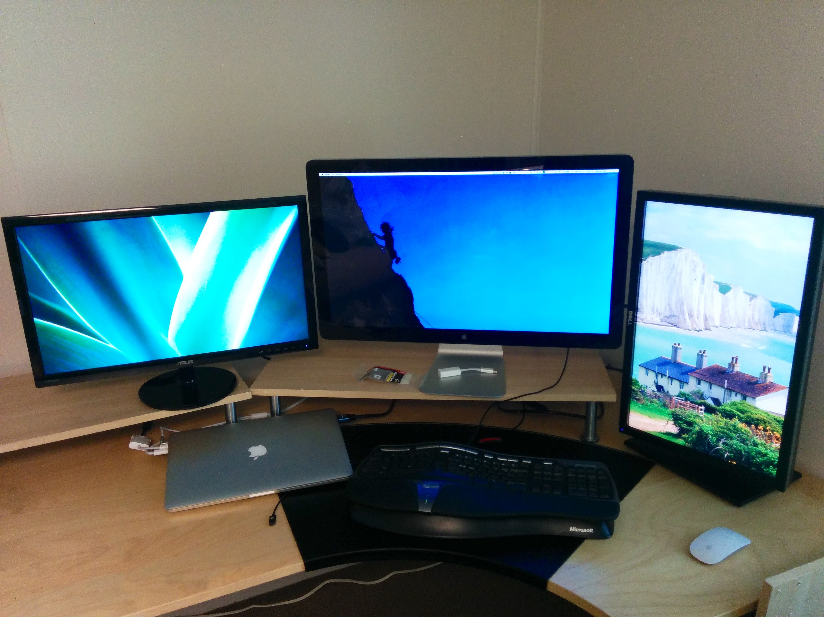

Slide 7


Slide 11


Slide 12

Software Is
Eating The World
🌎
Marc Andreessen, Founder Netscape
http://on.wsj.com/1Hkyems

Slide 13
Software Is
Eating The World
25th Percentile: $60,250
Median Pay: $79,530
75th Percentile: $103,570
90th Percentile: $130,800
Source: Bureau of Labor & Statistics

Slide 15
ex·pe·ri·ence
/ˌikˈspirēəns/
👑

Slide 16



LEARN NOW!
https://studio.code.org
https://www.codecademy.com
https://www.khanacademy.org/computing/computer-programming

Slide 17
Questions?
http://spencer.gibb.us

